Slide 1




FireBase

Slide 2
Firebase
Google Firebase is a Google-backed application development software that enables developers to develop iOS, Android and Web apps.
It is built on Google’s infrastructure and provides developers with a variety of tools and services to help them develop quality apps, grow their user base.

Slide 3
Firebase Services
Firebase offers a number of services, including:
Authentication: It supports authentication using passwords, phone numbers, Google, Facebook, Twitter, and more.
Realtime database: Data is synced across all clients in realtime and remains available even when an app goes offline.
Hosting: Firebase Hosting provides fast hosting for a web app; content is cached into content delivery networks worldwide.
Notifications: Notifications can be sent with firebase with no additional coding.

Slide 4
Firebase Services cont. . .
Cloud Messaging: Firebase Cloud Messaging (FCM) is a cross-platform messaging tool that lets companies reliably receive and deliver messages on iOS, Android and the web at no cost.
Test Lab: Firebase Test Lab is a cloud-based app-testing infrastructure. With one operation, developers can test their iOS or Android apps across a variety of devices and device configurations.
FireStore: Store and sync app data at global scale.

Slide 5
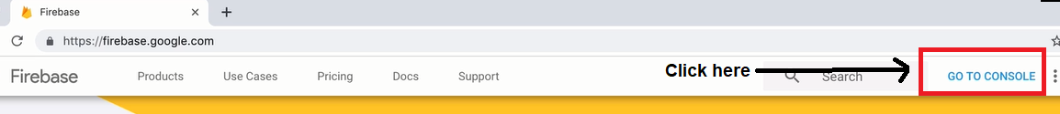
Firebase Project Setup
Before any Firebase services can be used, you have to create a project by https://firebase.google.com

Slide 6
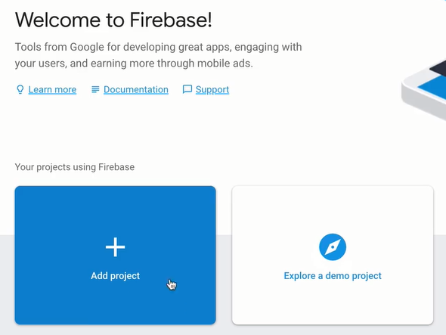
Firebase Project Setup cont. . .
Then select Add Project

Slide 7
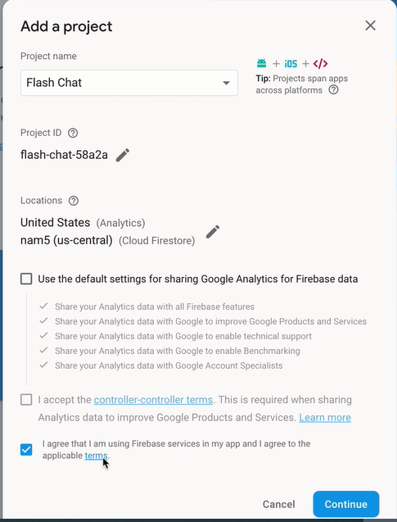
Firebase Project Setup cont. . .
Write Project name
Accept Term & Conditions

Slide 8
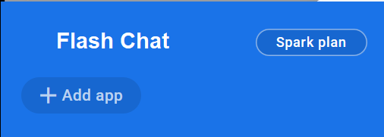
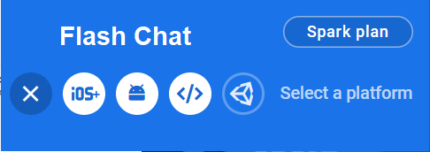
Adding Firebase to the Project
Click Add App
Select Platform

Slide 9
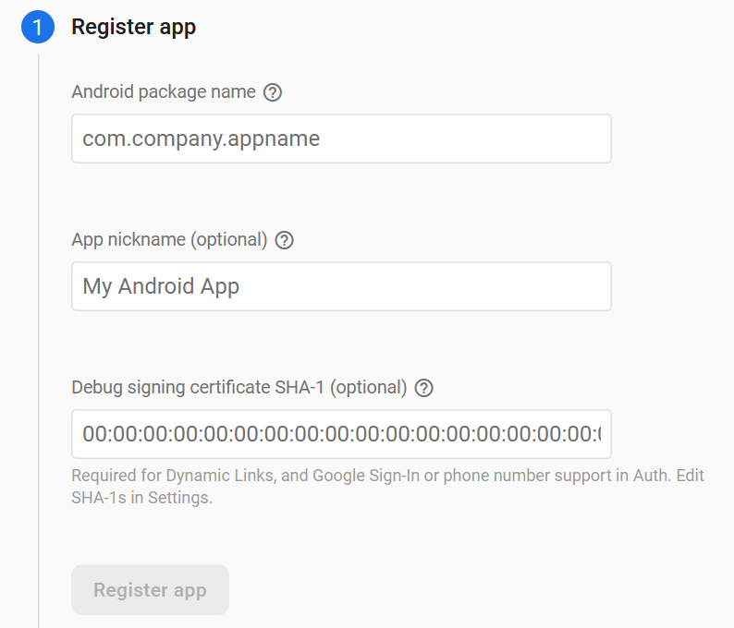
Register App
Provide Detail

Slide 10
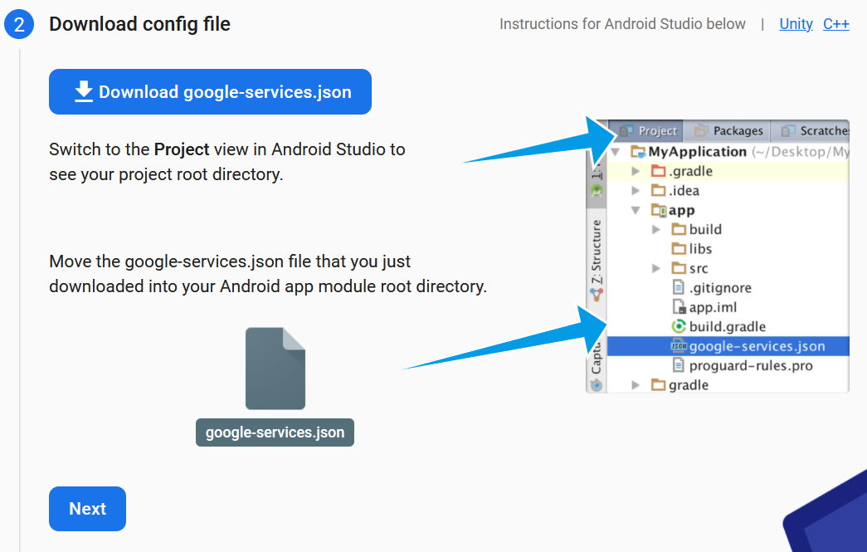
Download Config File
Download the json file
Place it in the
app directory

Slide 11
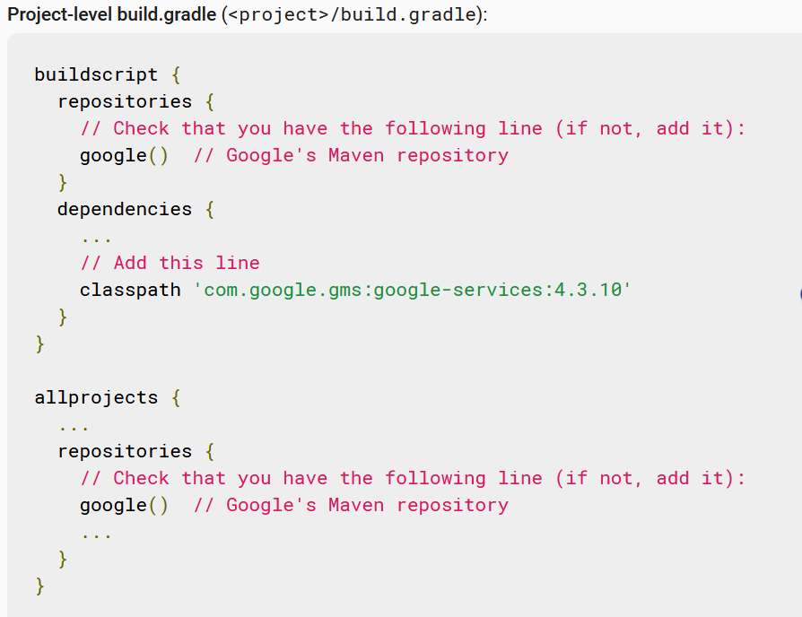
Add Firebase SDK
Configure project level gradle

Slide 12
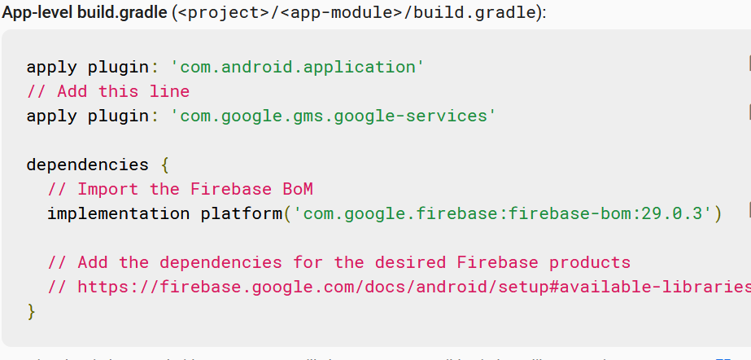
Add Firebase SDK cont. . .
Configure app level gradle
After adding SDK run You flutter app

Slide 13
Firebase Plugin
Before any Firebase services can be used, you must first install the firebase_core plugin, which is responsible for connecting your application to Firebase.
Add this plug in your pubspec.yaml
dependencies:
firebase_core: 0.3.4
For Firebase Authentication and cloud firestore add the following plugin
dependencies:
firebase_core: 0.3.4
firebase_auth: 0.8.4+4
cloud_firestore: 0.9.13+1

Slide 14

Thank
You !

